Slide 1

FindMyRide
CS461 - Database Systems
A Cross-Platform Ride-Sharing App For Dragons
Team: Samii Shabuse, Kennan Lu, Mustafa Bookwala
Notes:
Mustafa: 1-5
Kennan: 6-10
Samii: 11-14

Slide 2



Our team
FindMyRide
Samii Shabuse
Kennan Lu
Mustafa Bookwala
Role: Chief Software Engineer
Major: Computer Science
Minor: Mathematics, Data Science
Year: Senior
Role: Lead Database Engineer
Major: Computer Science
Minor: Art History
Year: Junior
Role: Project Manager
Major: Computer Science
Minor: Mathematics, Data Science
Year: Senior

Slide 3
Drexel students struggle to coordinate daily co-op commutes efficiently
No centralized system exists for safe, consistent ride-sharing
Students rely on messy group chats, social media, or ad-hoc solutions
Safety concerns, high costs (Uber/Lyft), and logistical uncertainty deter many from carpooling or public transit
FindMyRide
THE
PROBLEM

Slide 4
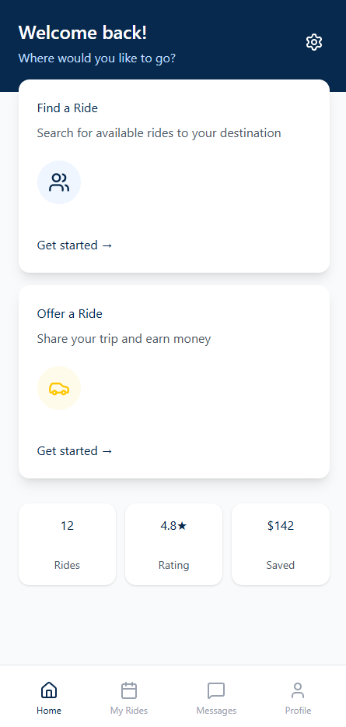
Our Solution
01
Post & Request Rides
02
Low-Cost & Safety First
03
Communicate Through Built-in Messaging

Slide 5
Target Users
FindMyRide
Drexel Students
Commuters
Anyone Coordinating Campus Rides
Students Without Cars

Slide 6
Requirements gathering
ER diagram
Relational model
Schema creation
Kotlin multi platform architecture
UI → Repository → SQLite flow
The Planning Process

Slide 7
Core Features (Summary)
FindMyRide
01
02
03
04
Drexel-Authenticated Login & Profiles
Post Rides
Request Rides
Affordable & Incentivized
Secure login via Drexel Single Sign On - only @drexel.edu users can register. Profiles store essential user info like name, role (driver/rider), and contact
Drivers can post available rides with pickup/drop details, choose how many seats to offer, and set operational preferences like price, timing, and car info
Riders can post available rides with pickup/drop details, choose how many seats to offer, and set optional preferences like price, timing, and car info
Riders save on commute costs with student-friendly pricing, while drivers can earn money for sharing their ride - a win-win model for everyone
05
06
07
08
In-App Messaging
Local SQLite Storage
Kotlin Multiplatform
Real-Time Status Update (Planned)
Built-in char with thread-based message history for smooth communication between riders and drivers - no external apps required
Offline-first design with local caching of rides, messaging, and preferences using SQLite - ensures consistency, and long-term scalability
Shared logic across Android and iOS using a single Kotlin codebase - improves performance, consistency, and long-term scalability
Future addition of live ride status, push notifications, and sync for confirmations, cancellations, and driver arrival

Slide 8
System Architecture + Database Tables
FindMyRide
Shared Layer:
Database Tables:
Business Logic
SQLite Database
Repositories
ViewModels
USER
VEHICLE
LOCATION
RIDE_OFFER
RIDE_REQUEST
RIDE_MATCH
RATING
MESSAGE_THREAD
MESSAGE
Platform Layers:
Android UI (Jetpack Compose)
Desktop UI (Compose Desktop)
iOS UI (Compose for iOS)

Slide 9
Database Schema Example
FindMyRide
USER
Column | Type | Constraints | Description
user_id | INTEGER | PRIMARY KEY | Unique Id for each user
email | TEXT | NOT NULL, UNIQUE | User’s email
username | TEXT | NOT NULL, UNIQUE | Display username
password_hash | TEXT | NOT NULL | Password hash
phone_number | TEXT | (optional) | Phone number
role | TEXT | CHECK (role in ‘rider’,’driver’,’both), NOT NULL | User type
rating_avg | REAL | CHECK (0-5), DEFAULT 2.5 | Average rating
created_at | TEXT | NOT NULL, DEFAULT datetime(‘now’) | Sign Up timestamp

Slide 10
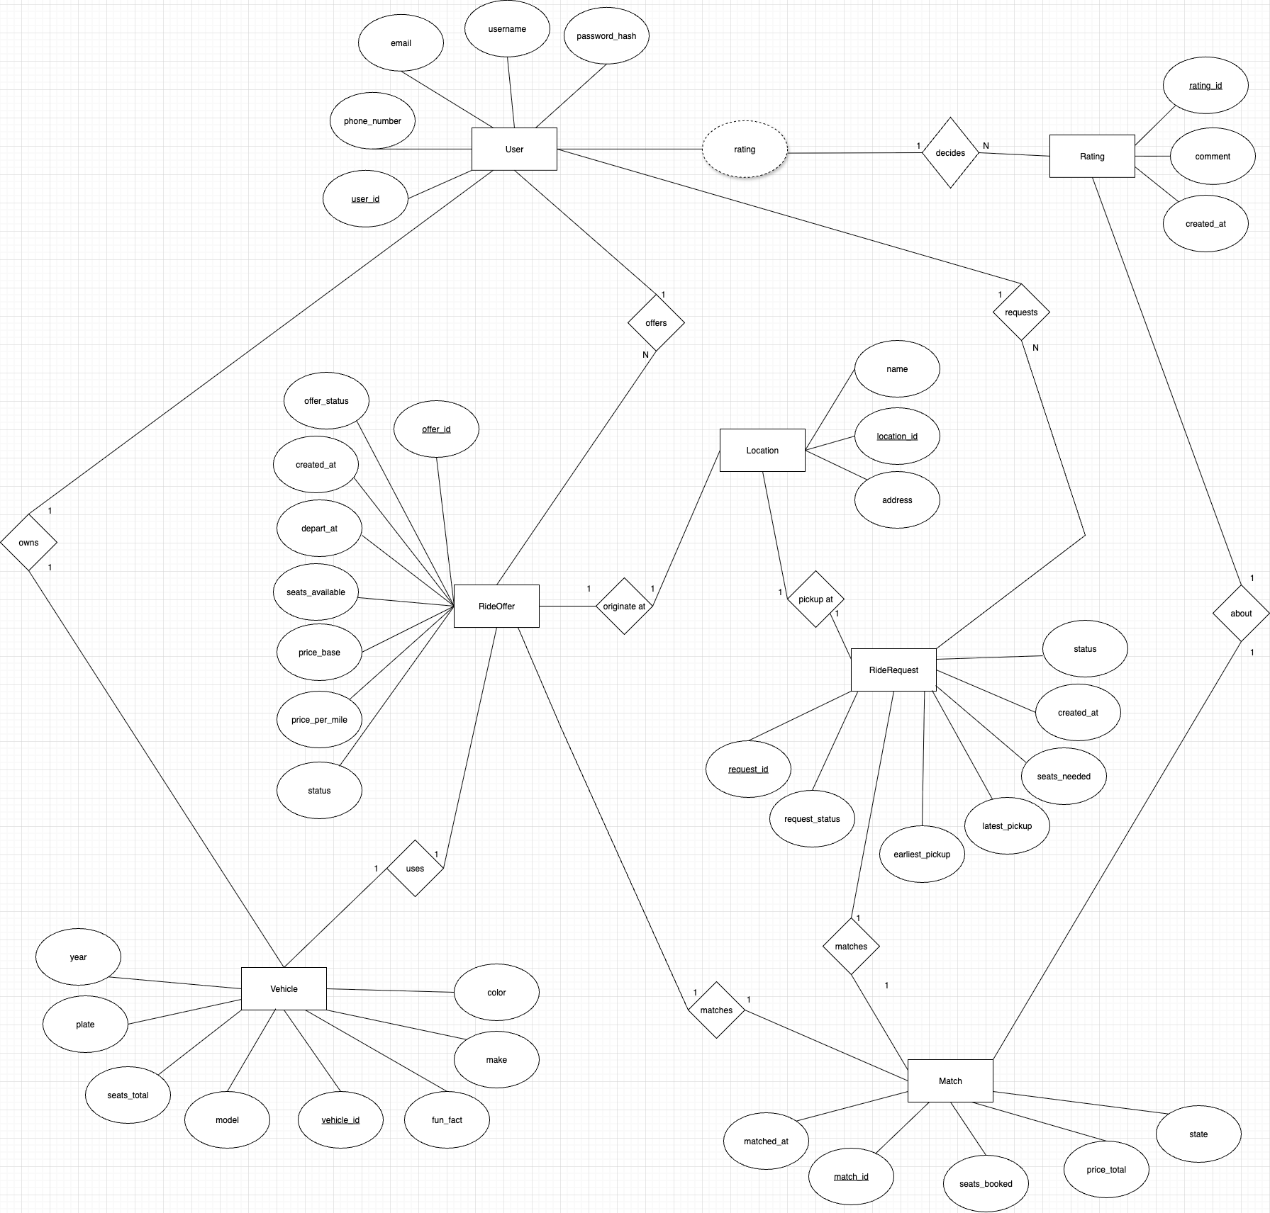
Database Design ER Diagram
FindMyRide
Tables:
Users
Vehicles
Rides
RideRequests
MessageThreads
Messages
Key Relationships:
User → Vehicles (1-many)
User → Rides (1-many)
Thread → Messages (1-many)
ER Diagram with Chen Notation

Slide 11
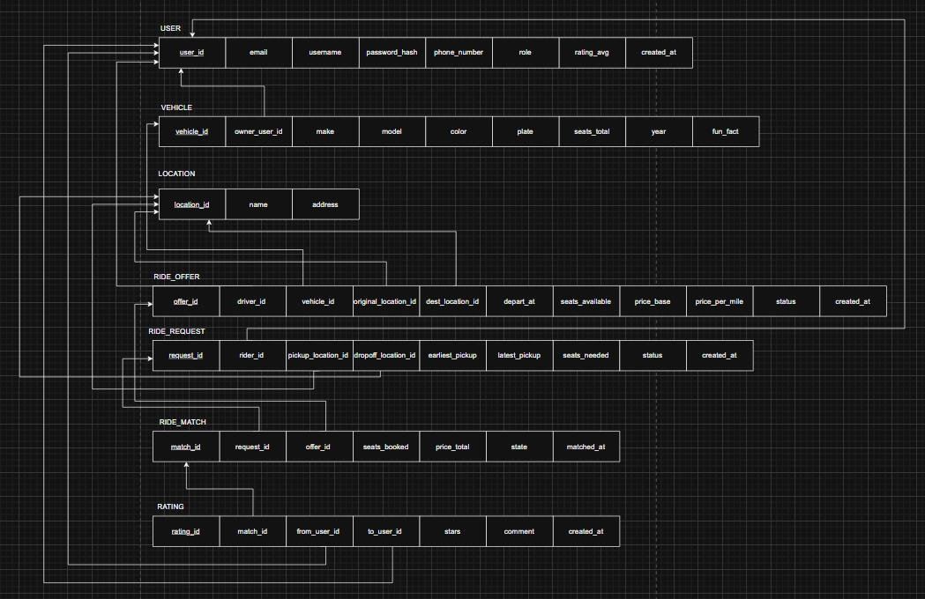
Relational Database Design
FindMyRide
Tables:
Users
Vehicles
Rides
RideRequests
MessageThreads
Messages
Key Relationships:
User → Vehicles (1-many)
User → Rides (1-many)
Thread → Messages (1-many)
Relational Diagram

Slide 12
How We Built It
FindMyRide
THE SOLUTION
01
02
03
04
MANUAL GRADLE & PLUGIN SETUP
SWITCHED TO PHYSICAL DEVICE TESTING
SQLite HELPER WITH MIGRATION LOGIC
CUSTOM DATA MODEL FOR CHAT THREADS
We manually configured Kotlin Multiplatform plugins and dependencies, ensuring macOS and Android Studio ran stable builds with Compose
To bypass emulator issues, we shifted to testing on physical Android devices, allowing smoother debugging and UI validation
Built a modular SQLite helper to manage tables, schema upgrades, and safe inserts - keeping data persistent andapp state clean
Designed lightweight thread-based models that cached locally while syncing intelligently with user actions and profile context.

Slide 13
Data Sources & How The Data Was Created
Manually inserted fake Drexel users
Used SQL scripts to seed vehicles + rides
Validated inserts in CLI/DB Browser
Used CRUD inside the app to create some entries
FindMyRide

Slide 14
We Faced
FindMyRide
THE CHALLENGES
01
02
03
04
SETTING UP KOTLIN MULTIPLATFORM ON macOS
EMULATOR & LIVE PREVIEW ISSUES
SQLite INTEGRATION & SCHEMA UPDATES
THREADED MESSAGING ARCHITECTURE
Configuring Android Studio on mac with Kotlin Multiplatform support required extra plugins and manual dependency fixes
The Android Emulator often failed to render live previews due to resource constraints and M2 chip compatibility
Connecting the app to a local SQLite DB and making schema updates without breaking existing flows took time, especially managing migration safely
Structuring message threads cleanly while keeping them stored and synced locally required additional abstraction nd custom view modeling

Slide 15
Live Demo
Crud
Overview
CRUD Demo
(Profile → Vehicles page)
Create: Add new vehicle
Read: Load existing profile + vehicle list
Update: Edit vehicle details
Delete: Remove a vehicle

Slide 16
Lesson Learned
FindMyRide
Samii Shabuse
Kennan Lu
Mustafa Bookwala
Lesson: I learned how to code with Kotlin Multiplatform a framework I never used, and learned how to integrate a database into it.
Lesson: I learned how to create a locally hosted SQLite database, including how to define its structure and schema along with populating it with mock data.
Lesson: I learned how to develop an iOS application without knowing Swift. Being able to navigate around the complex permissions of Mac and code in iOS was definitely rewarding.

Slide 17
Thank you

